Slide 1


Wireless LAN
Without cables!
Wireless network communication over short distances
  Radio or infrared signals
Extends an existing wired local area network

Slide 2


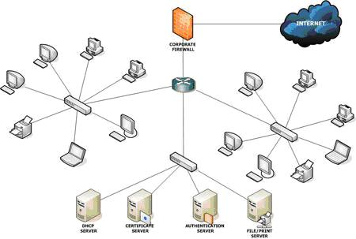
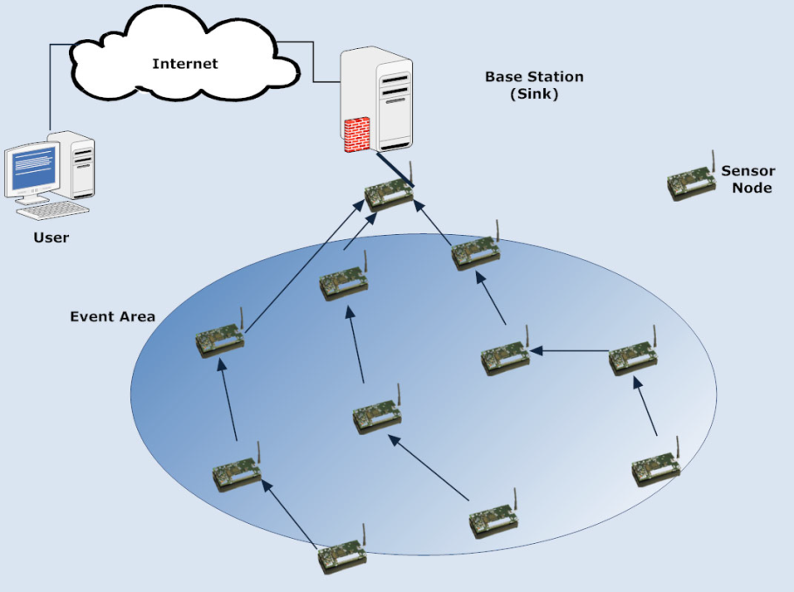


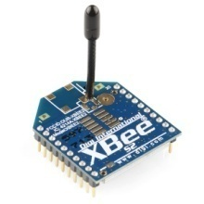
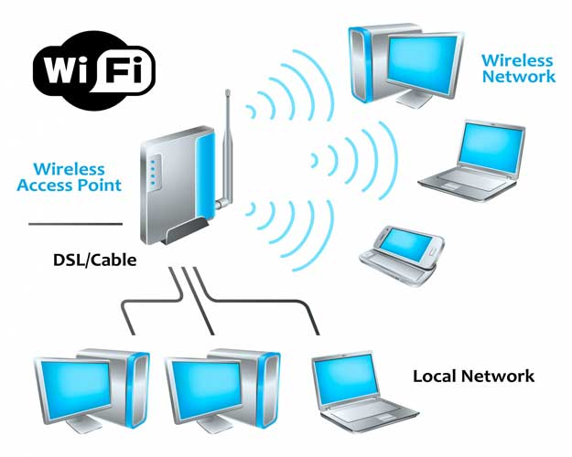

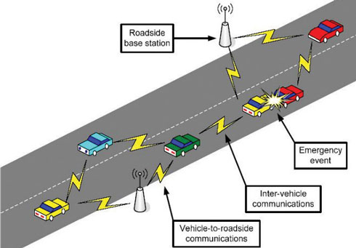

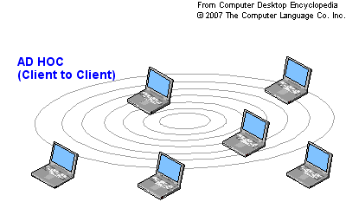

Slide 3
15.1.1 Architectural Comparison
Let us first compare the architecture of wired and wireless LANs to give some idea of what we need to look for when we study wireless LANs.
15.<number>
Notes:
15.#

Slide 4
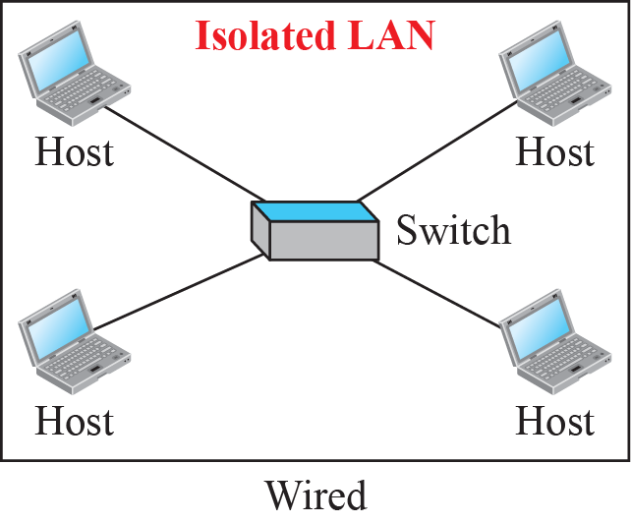
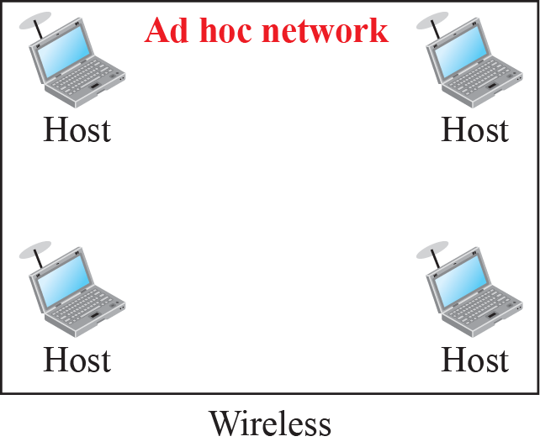
Figure 15.1: Isolated LANs: wired versus wireless
15.<number>
Notes:
15.#

Slide 5
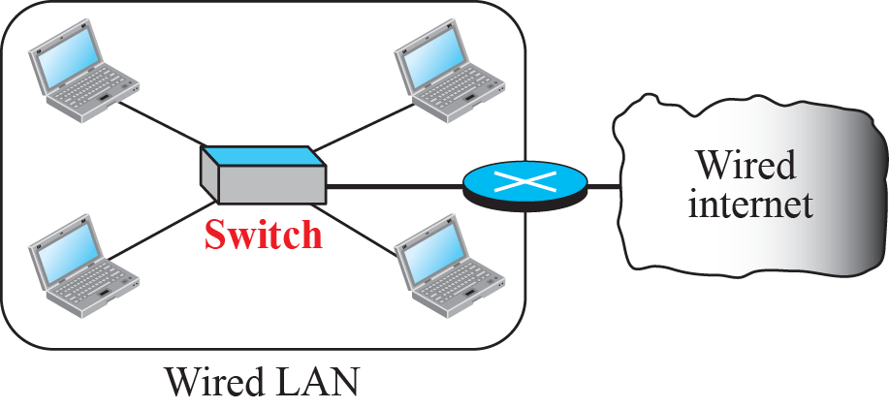
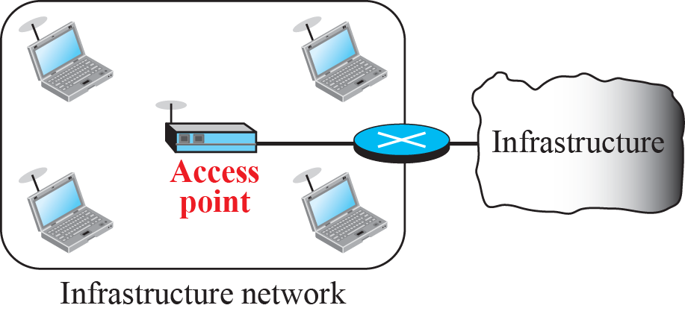
Figure 15.2: Connection of a wired LAN and a wireless LAN to other
networks
Allows any device within its range to access the resources of the WLAN network.
15.<number>
Notes:
15.#

Slide 6
15.1.2 Characteristics
There are several characteristics of wireless LANs that either do not apply to wired LANs or the existence of which is negligible and can be ignored. We discuss some of these characteristics here to pave the way for discussing wireless LAN protocols.
15.<number>
Notes:
15.#

Slide 7
    15-2 IEEE 802.11 PROJECT
IEEE has defined the specifications for a wireless LAN, called IEEE 802.11, which
covers the physical and data-link layers.
Term WiFi (short for wireless fidelity) as a synonym for wireless LAN.
WiFi, however, is a wireless LAN that is certified by the WiFi Alliance.
15.<number>
Notes:
15.#

Slide 8
15.2.1 Architecture
The standard defines two kinds of services: the basic service set (BSS) and the extended service set (ESS).
15.<number>
Notes:
15.#

Slide 9
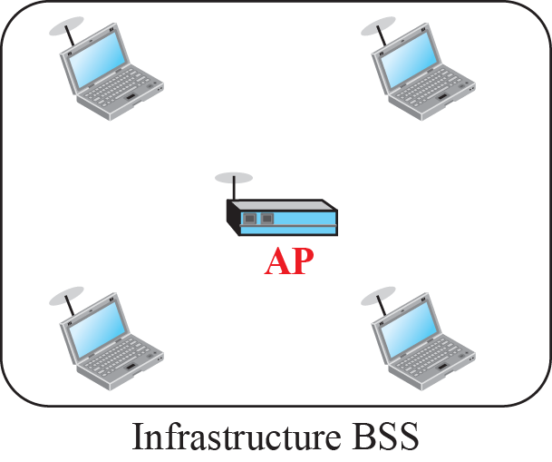
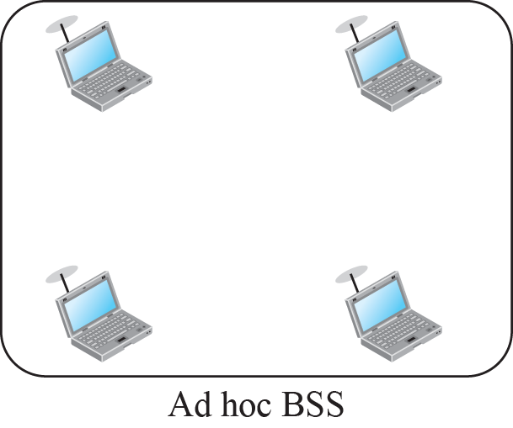
Figure 15.4: Basic service sets (BSSs)
Basic service set (BSS) provides the basic building-block of an 802.11 wireless LAN
15.<number>
Notes:
15.#

Slide 10

Note
A BSS without an AP is called an ad hoc network;
a BSS with an AP is called an infrastructure network.
14.<number>

Slide 11
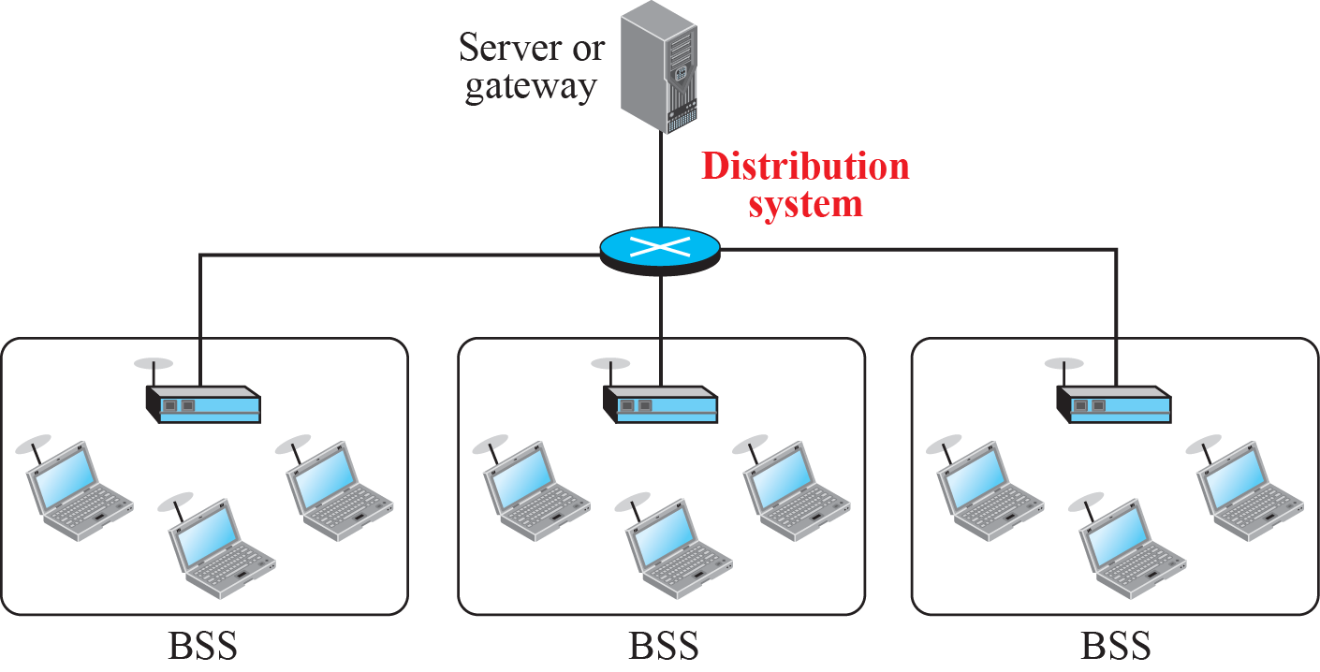
Figure 15.5: Extended service set (ESS)
15.<number>
Notes:
15.#

Slide 12
15.2.2 MAC Sublayer
IEEE 802.11 defines two MAC sublayers:
the distributed coordination function (DCF) and point coordination function (PCF).
.
15.<number>
Notes:
15.#

Slide 13
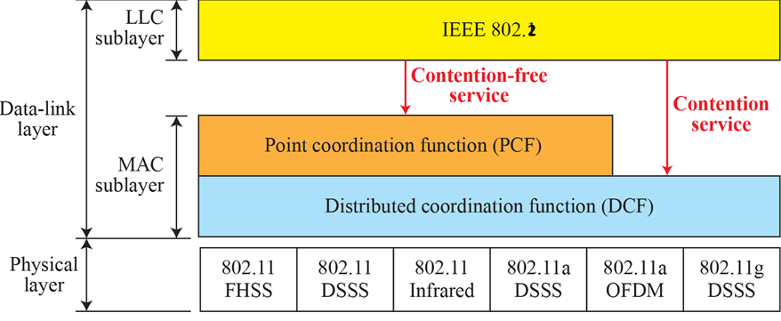
Figure 15.6: MAC layers in IEEE 802.11 standard
15.<number>
Notes:
15.#

Slide 14


Distributed Coordination Function (DCF)
Uses CSMA/CA as the access method
Why not CSMA/CD algorithm?
For CD, station must be able to send data and receive signals at same time ; increased BW requirements ; costly stations.
  use same frequency for transmission ; simultaneously monitoring not possible
The hidden station problem prevents collision detection
The distance between stations can be large (Signal fading prevent hearing collision at other end)

Slide 15
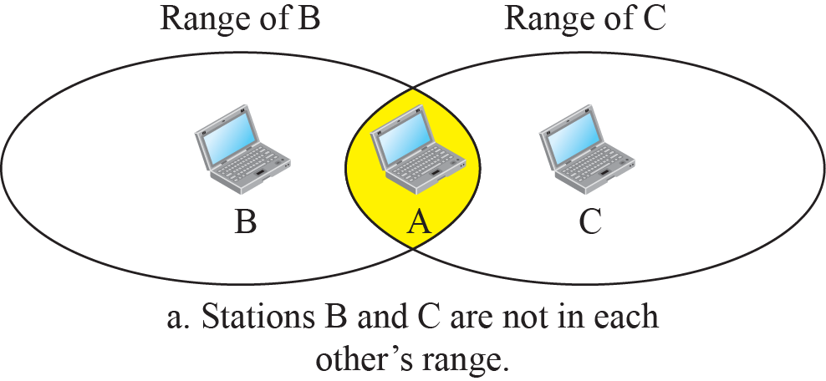
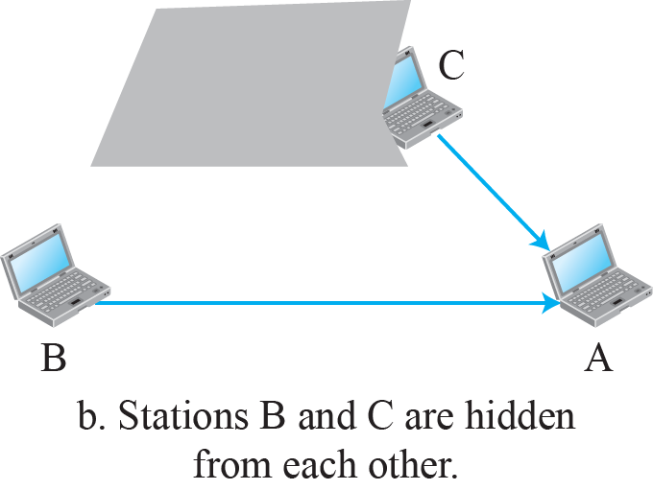
Figure 15.3: Hidden station problem
15.<number>
Notes:
15.#

Slide 16













Figure 15.7: CSMA/CA and NAV
15.<number>
Notes:
15.#

Slide 17


How collision is avoided in CSMA/CA
Network Allocation Vector (NAV)
RTS frame includes duration of the time that it needs to occupy the channel
Stations that are affected by this transmission creates a timer called NAV
Each station before sensing the channel to see if it’s idle, first checks the NAV for expiry

Slide 18


Collision During Handshaking Process
Two or more stations may try to send RTS at the same time leads to collision
Sender assumes a collision if it has not received a CTS frame from the receiver
Back-off strategy is employed

Slide 19


Interframe Spaces
MAC Frames txns
  Time gap – IFS
  Priority Mechanism
3 types of IFS
  SIFS (Short) – 10us
    Highest priority frames
    ACK, CTS, Poll response
  PIFS (PCF-IFS) – 30us
    For Polling
  DIFS (DCF-IFS) – 50us
    Longest interframe gap (data, management )

Slide 20

Figure 14.4 CSMA/CA flowchart
14.<number>

Slide 21
Figure 15.6: MAC layers in IEEE 802.11 standard
Infrastructure – DCF or DCF-PCF Coexistence
15.<number>
Notes:
15.#

Slide 22


PCF (Point Co-ordination Function)
Centralized communication control
  Optional access method implemented in infrastructure
Contention Free Access
Point Coordinator (PC)
  Polls stations in Round Robin for sending/receiving data
PCF
  High Priority & Time-Sensitive data
How could PCF and DCF co-exist in BSS?
  Same time AP wants to use PCF ; station wants to use DCF;

Slide 23

Repetition Interval
Coexist solution
  Contention Free Period (CFP) + Contention Period (CP)
  CFP & CP alternate in cyclic manner
  CFP + CP = Superframe (Nominal length) = 1 cycle
PCF
  PC sends beacon signal
  PC polls in round robin manner
  1 round – CF-End frame

Slide 24
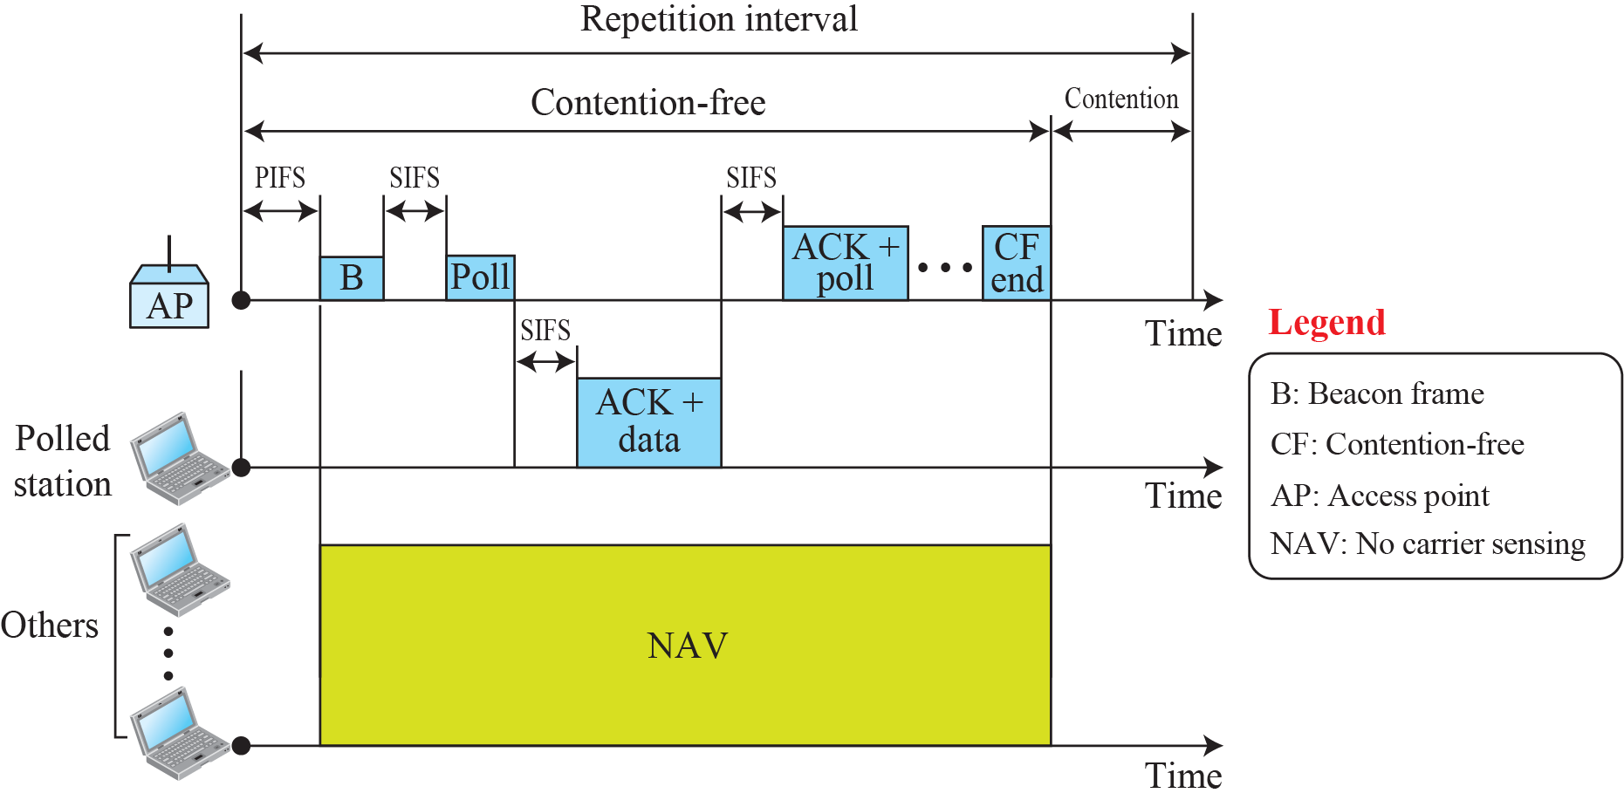
Figure 15.8: Example of repetition interval
15.<number>
Notes:
15.#

Slide 25
Interframe Spaces
MAC Frames txns
  Time gap – IFS
  Priority Mechanism
3 types of IFS
  SIFS (Short) – 10us
    Highest priority frames
    ACK, CTS, Poll response
  PIFS (PCF-IFS) – 30us
    For Polling
  DIFS (DCF-IFS) – 50us
    Longest interframe gap (data, management )

Slide 26

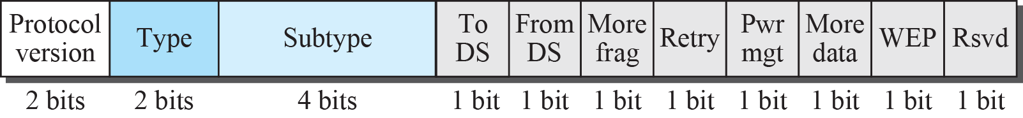
Figure 15.9: Frame format
Sequence no of frame
15.<number>
Notes:
15.#

Slide 27

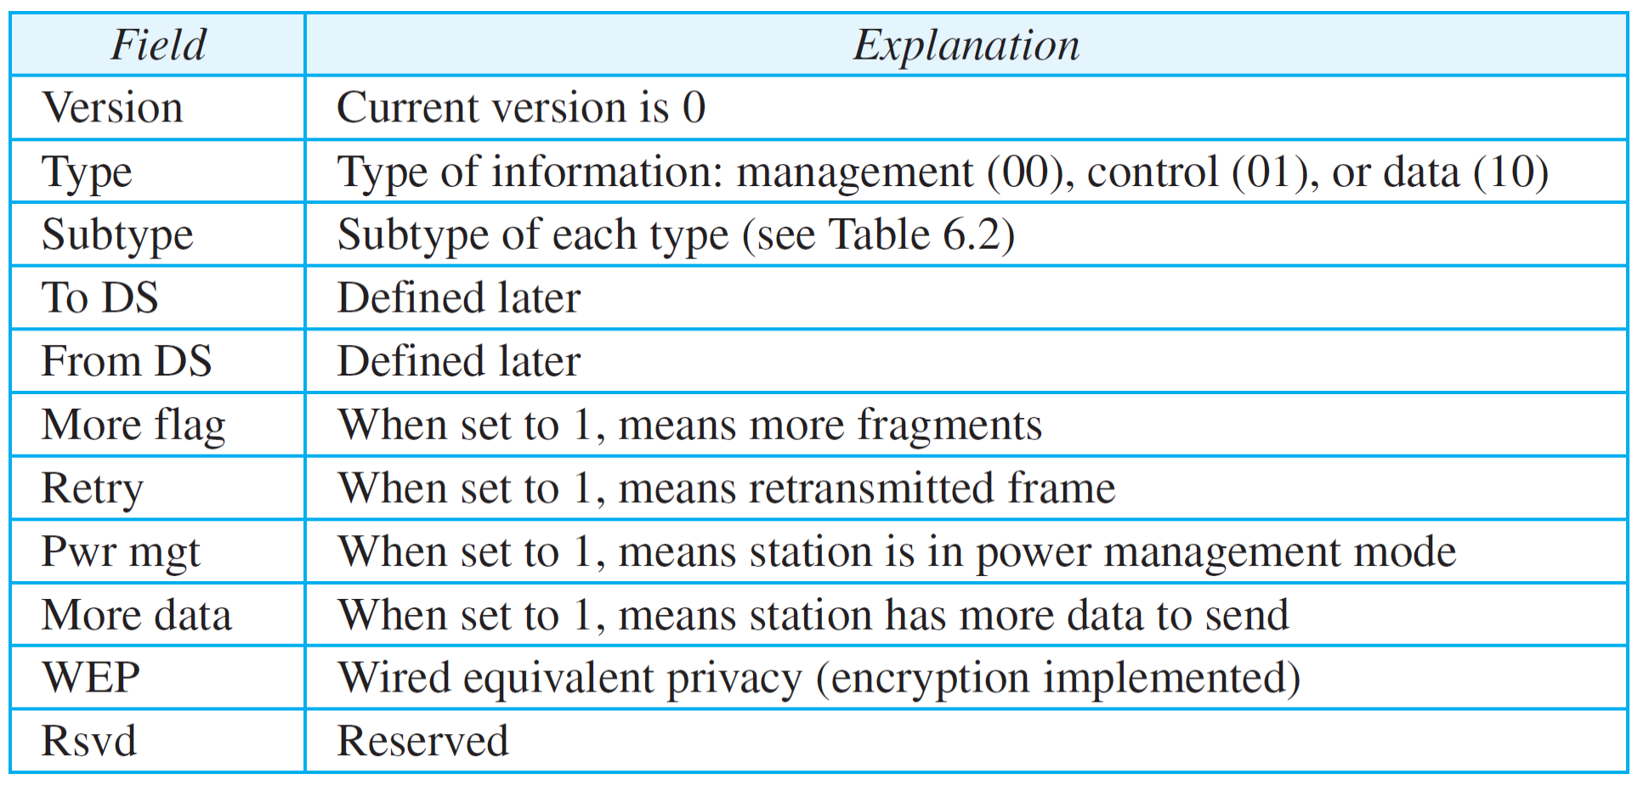
Table 15.1: Subfields in FC field
15.<number>

Slide 28

Management Functions
WLAN provides mobility
  One BSS to another
  One ESS to another
Association
  Station & AP of BSS
  APs of ESS communicate for delivery
Re-association
  Movement of station from one BSS to another
Disassociation
  Termination of an existing association between station & AP

Slide 29
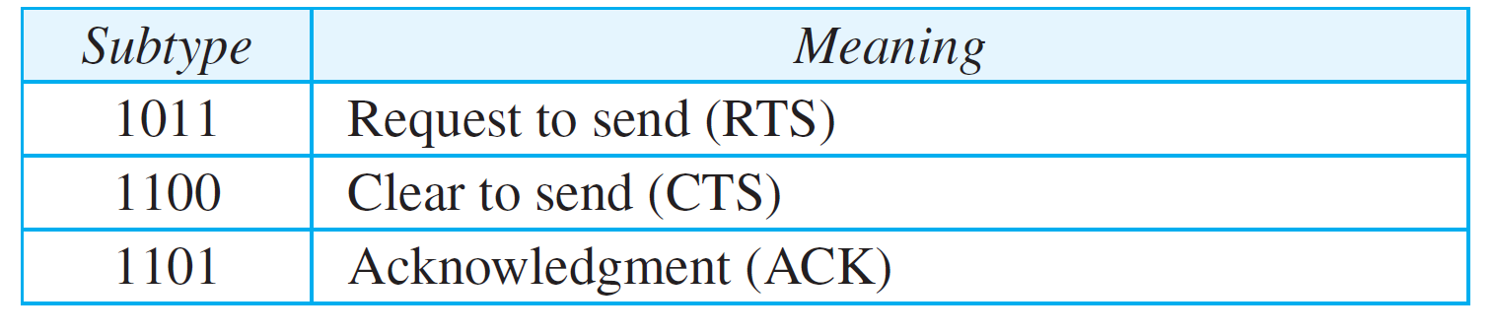
Table 15.2: Values of subfields in control frames
15.<number>

Slide 30

Authentication & Encryption
No Physical connectivity of stations
Prone to
  Un-Authorized Access
  Eavesdropping
Prior to Association
  Authenticate identity
  Encryption of message exchanges

Slide 31
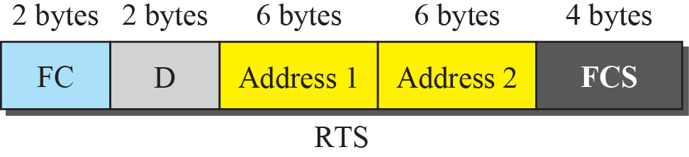
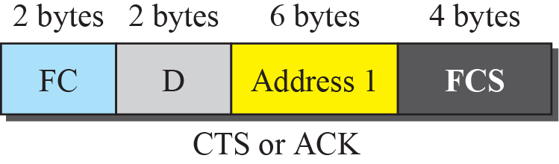
Figure 15.10: Control frames
15.<number>
Notes:
15.#

Slide 32
15.2.3 Addressing Mechanism
The IEEE 802.11 addressing mechanism specifies four cases, defined by the value of the two flags in the FC field, To DS and From DS.
Each flag can be either 0 or 1, resulting in four different situations.
The interpretation of the four addresses (address 1 to address 4) in the MAC frame depends on the value of these flags
15.<number>
Notes:
15.#

Slide 33
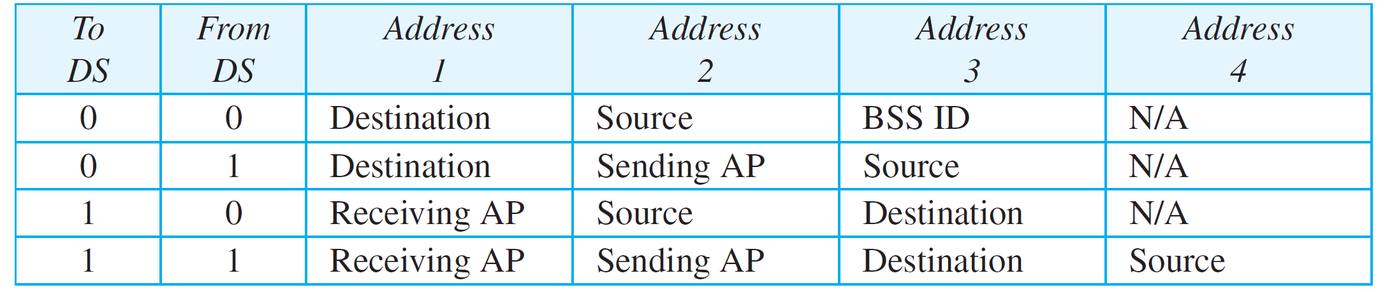
Table 15.3: Addresses
Frame not going through DS?
Not coming from DS?
Address 1 – Address of the next device
Address 2 – Address of previous device
Address 3 – Final Destination Station if not defined by address 1
Address 4 – Address of original source station if it is not the same as address 2
15.<number>

Slide 34
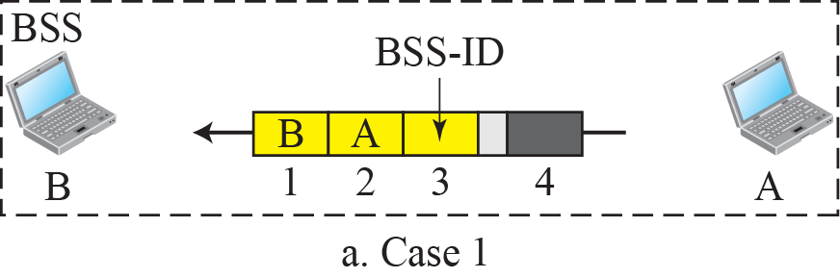
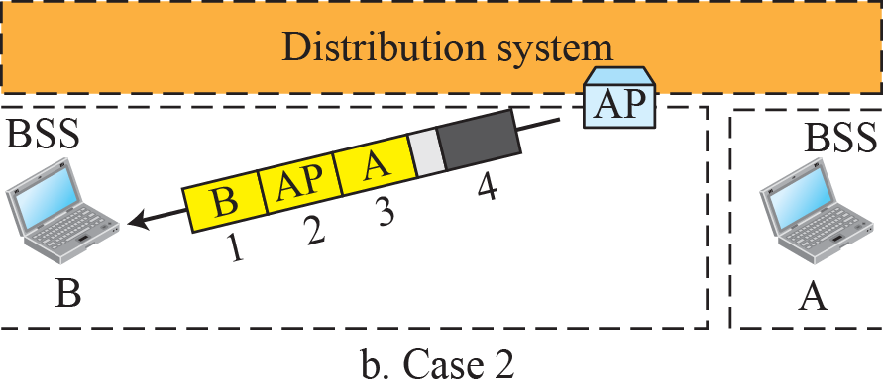
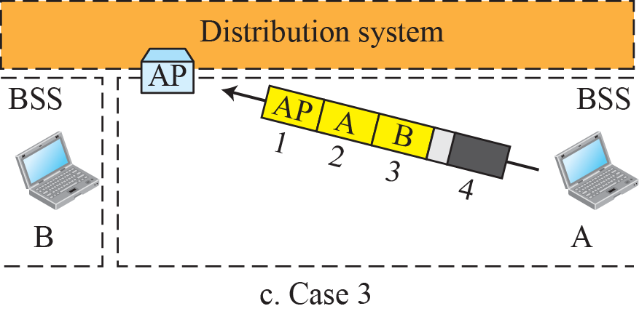
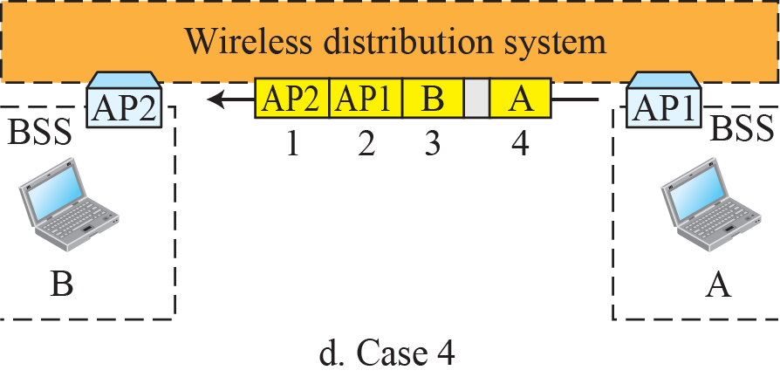
Figure 15.11: Addressing mechanisms
15.<number>
Notes:
15.#

Slide 35
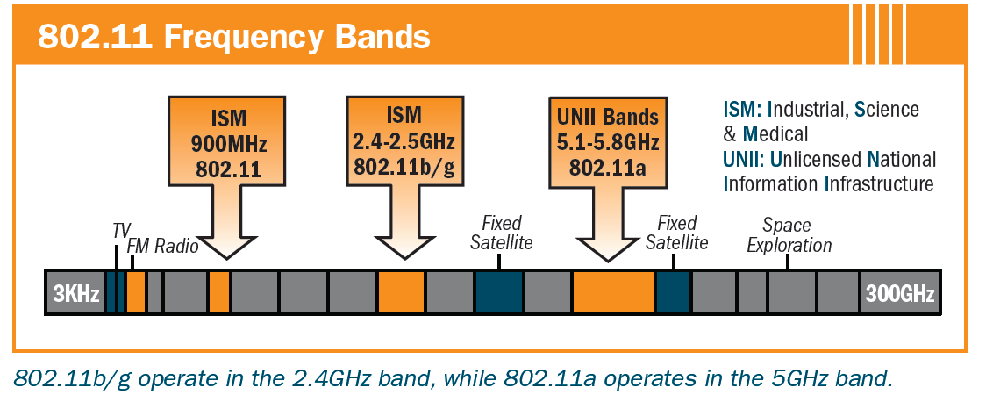
15.2.4 Physical Layer
All implementations, except the infrared, operate in the industrial, scientific, and medical (ISM) band, which defines three unlicensed bands in the three ranges 902–928 MHz, 2.400–4.835 GHz, and 5.725–5.850 GHz.
15.<number>
Notes:
15.#

Slide 36
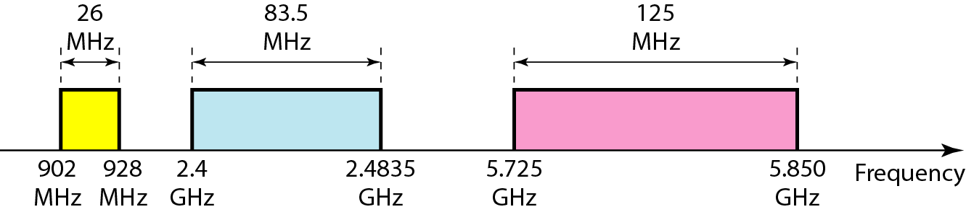
Figure 14.14 Industrial, scientific, and medical (ISM) band
14.<number>

Slide 37
IEEE 802.11 Physical Layer Options
 | Frequency Band | Bit Rate | Modulation Scheme
802.11 | 2.4 GHz | 1-2 Mbps | Frequency-Hopping Spread Spectrum, Direct Sequence Spread Spectrum
802.11b | 2.4 GHz | 11 Mbps | Complementary Code Keying & QPSK
802.11g | 2.4 GHz | 54 Mbps | Orthogonal Frequency Division Multiplexing & CCK for backward compatibility with 802.11b
802.11a | 5-6 GHz | 54 Mbps | Orthogonal Frequency Division Multiplexing

